Slide 1

PUBG Game Play Analysis

Slide 2
Introduction
PUBG(Player Unknown’s Battlegrounds) is a well known online multiplayer battle royal game. The available safe area of the game's map decreases in size over time, directing surviving players into smaller areas to force encounters. The last player or team standing wins the round. Player or team who win a match are greeted with “Winner winner chicken dinner.”
As PUBG offering 100 players per match and most elements such as safe area runs randomly, it will be helpful for the players to make a analysis to predict the probably safe area to prevent huge damage due to traveling in unplayable zone.

Slide 3
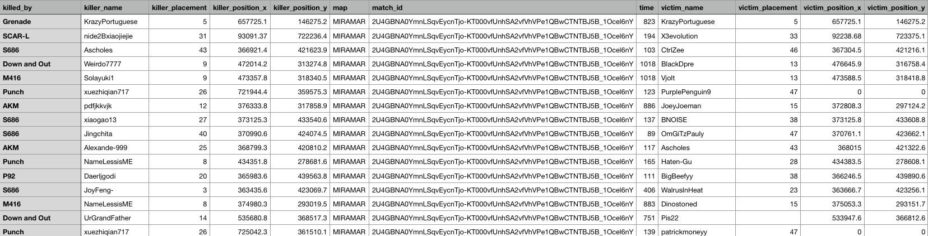
Prepare
In order to analysis the map, we need huge amount of data.
Data is obtained from Kaggle
Data does not contain information about safe zone

Slide 4
Heatmap happened in the first 2 mins

Slide 5
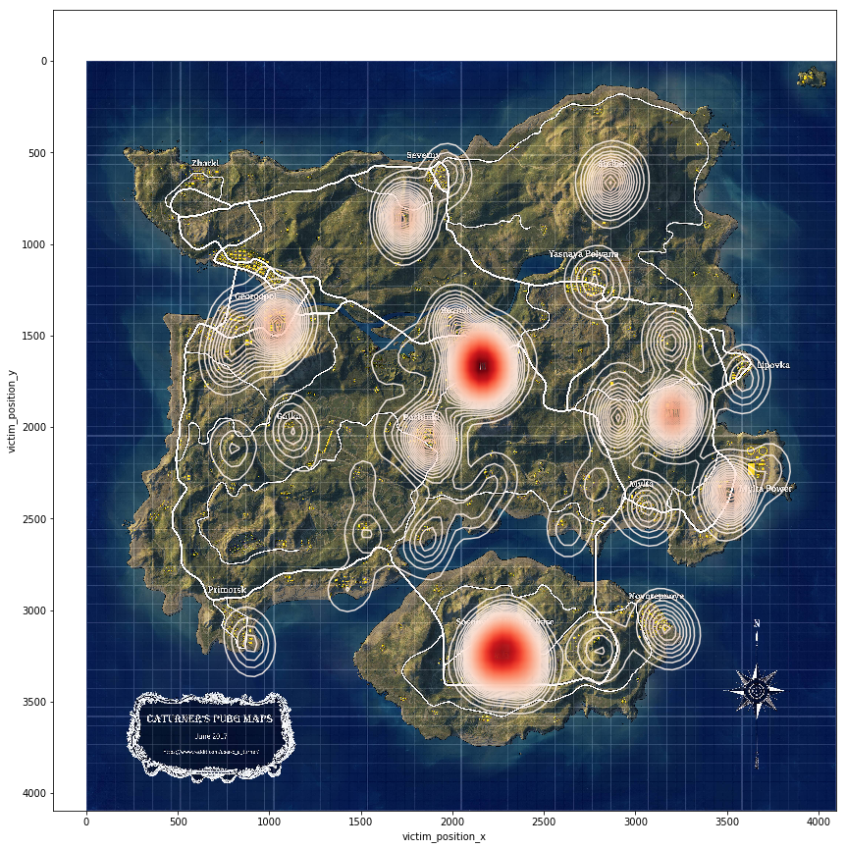
Heatmap for death take placed in the first 2 mins
Find the victims dead in the first 2 mins (120 on chart)
Convert the position from chart(both map are 8 x 8) to actual location on image
Create contour lines use those victim's death location (sns.kdeplot)

Slide 6
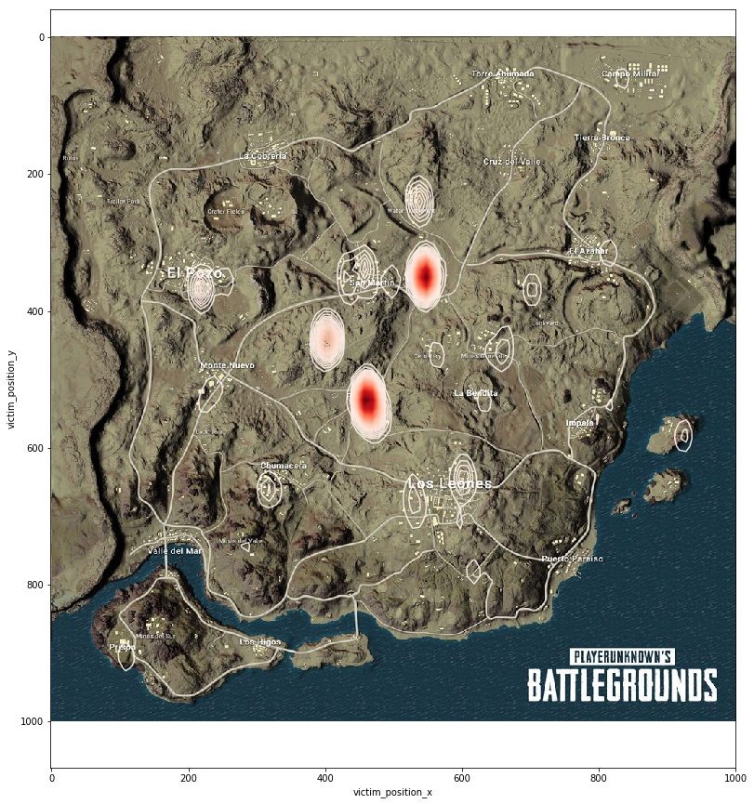
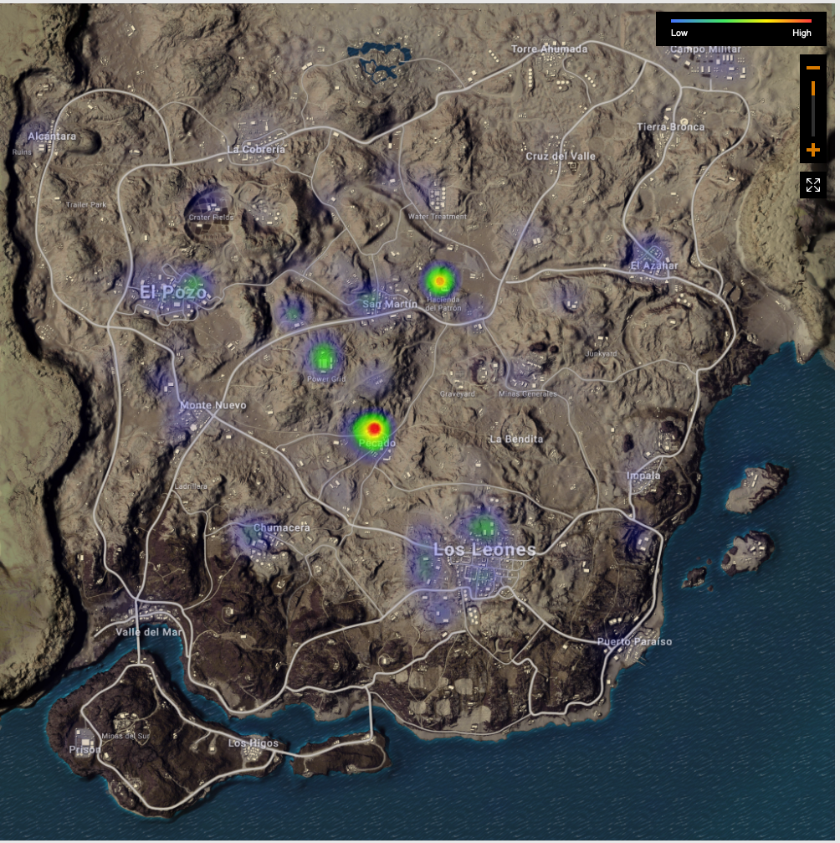
Compare with op.gg (landing spot)
Notes:
cont

Slide 7
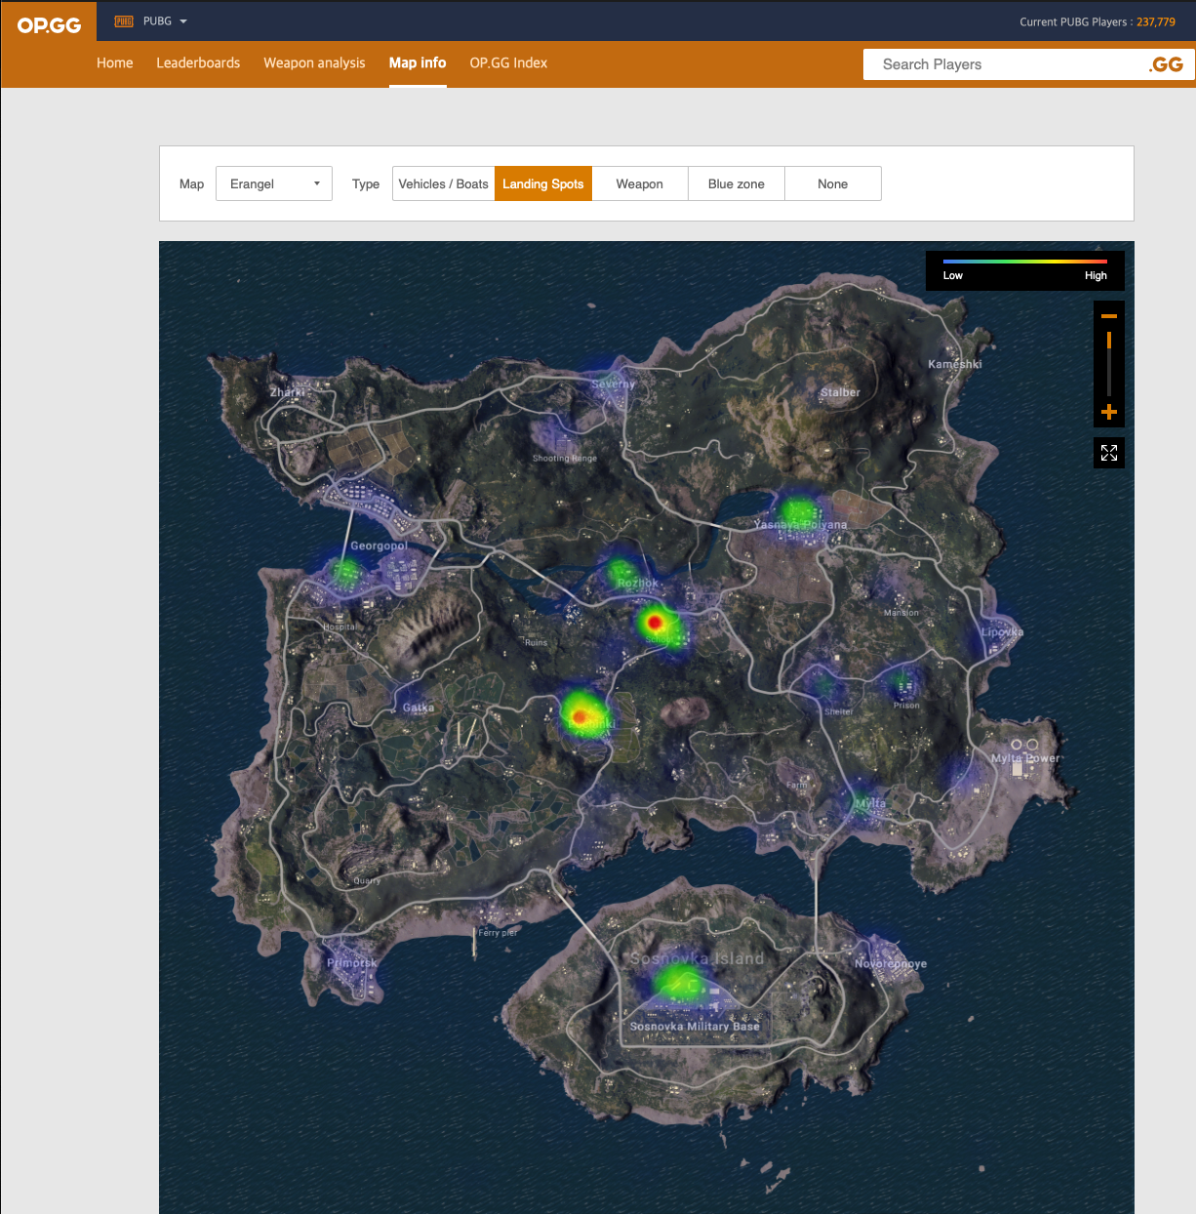
Compare with op.gg(landing spots)

Slide 8
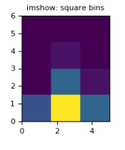
Final zone heatmap
The data set won’t record the final available play area. We have to use those victim killed by winner to find out the final area.
Using the location of the victim killer by the winner to predict the final zone
Use Histogram to count the weight
Add a Gaussian filter to make the heatmap
Histogram2d imshow without Gussian Filter

Slide 9
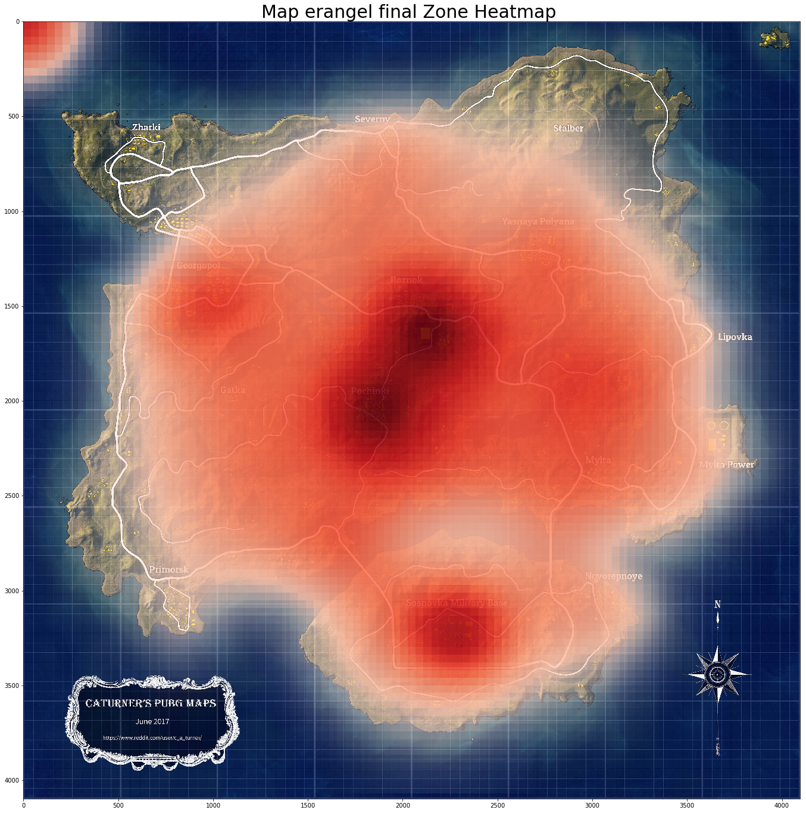
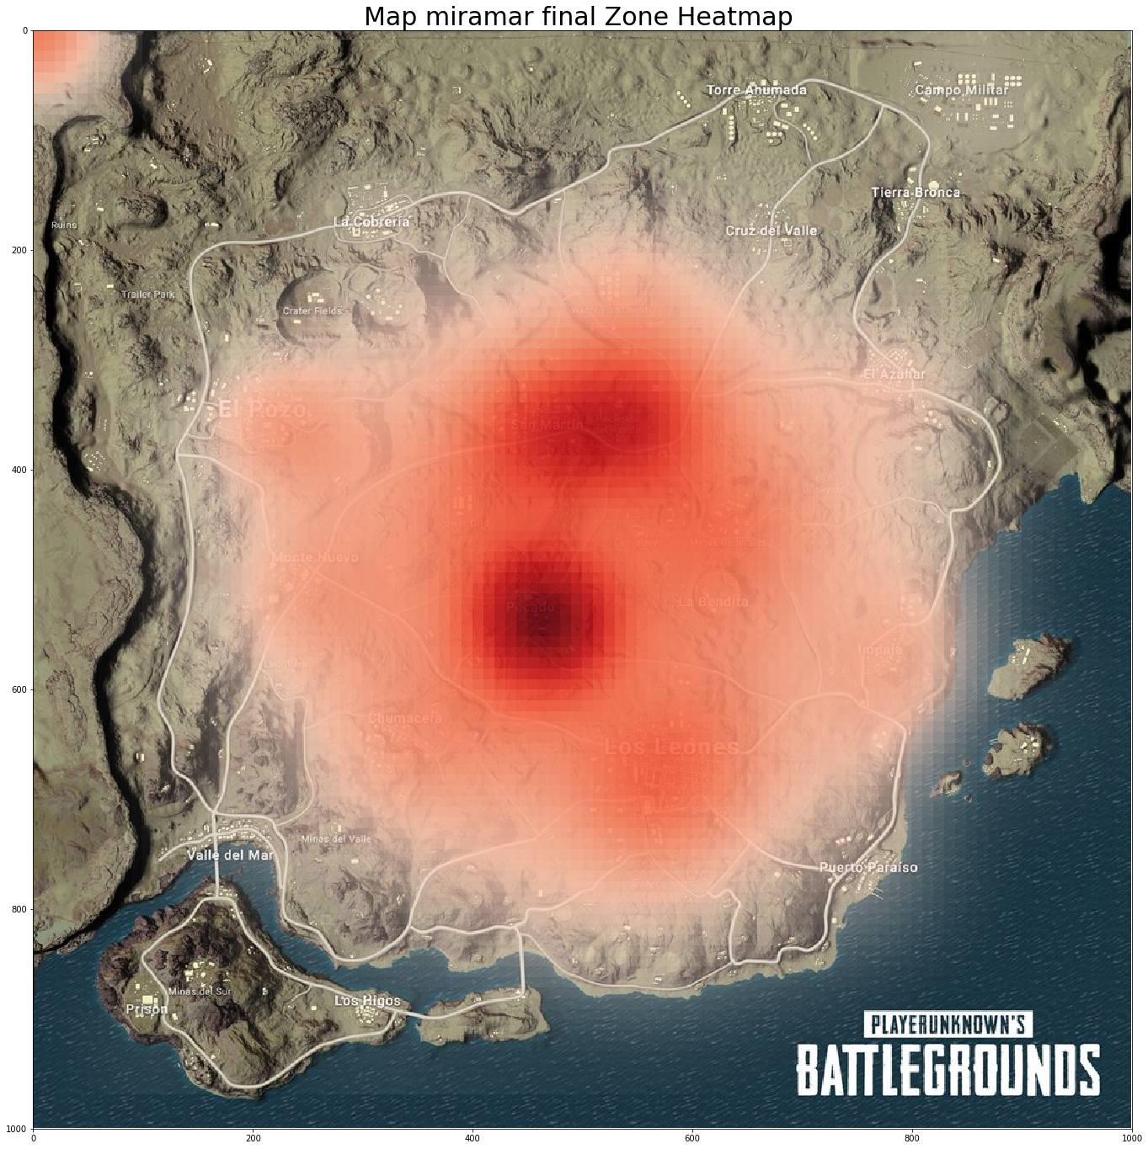
Result

Slide 10
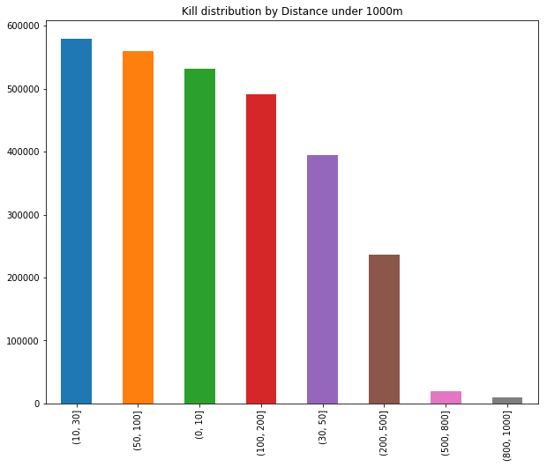
Kill distribution by Distance
Calculate the distance between the victim and killer. (d= sqrt((x1-x2)^2+ (y1-y2)^2))
Most common range 10, 30, 50, 100, 200, 500, 800, 1000
And place those kill action in the bin (pd.cut)
Most are close combat under 100m

Slide 11
Future work
Include a method to show how many kills the winner have.
Favorite weapon choose by the the player
Add filter to remove those data which caused hot zone on the top left corner.

